Slide 1
Introduction to Data Science with Google Colab
Python, Numpy, Pandas & Matplotlib
Kanak Raj
GDG BIT Mesra

Slide 2
Topics to be covered:
Jupyter Notebooks & Colab
Python 3
Numpy
Pandas

Slide 3
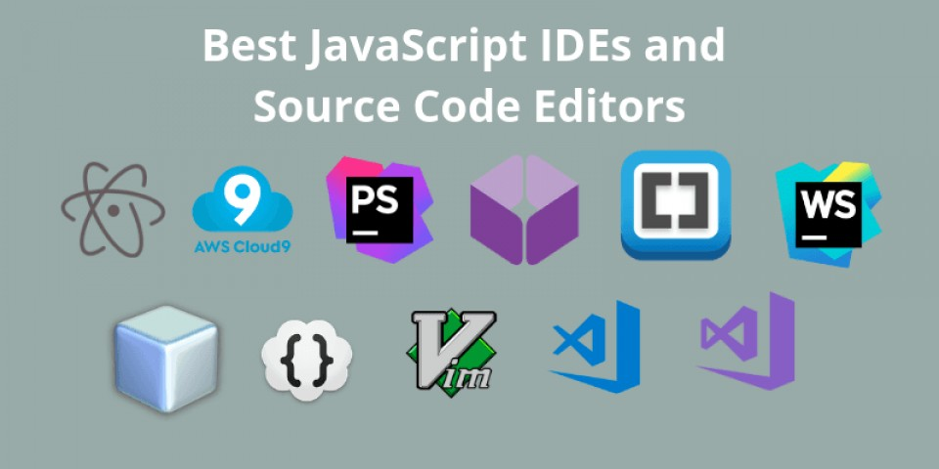
Jupyter Notebooks
Traditional IDEs
Most IDEs include a source code editor, debugger, and compiler. They work perfectly for tech assessments for programmers and developers. Not for data science and machine learning assignments though.
In data science you never want to re-run the whole code again. You just want to add chunks of line and see how its performing

Slide 4

Jupyter Notebooks
https://jupyter.org/documentation
A read–eval–print loop (REPL) is a simple interactive computer programming environment that takes single user inputs, executes them, and returns the result to the user;
A program written in a REPL environment is executed piecewise.
Open-source Web Application
Notebooks not only work like an IDE, but also as a presentation or education tool
Based on IPython

Slide 5
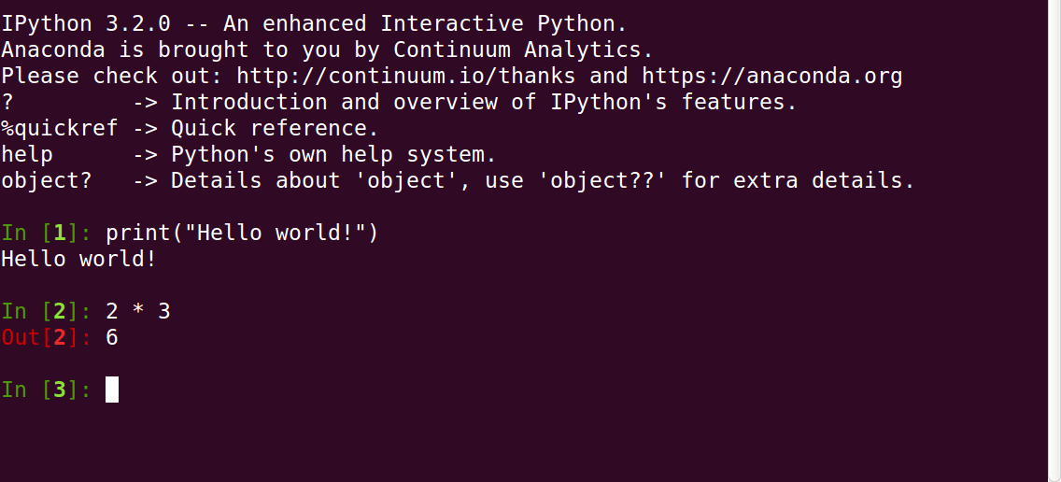
IPython is an interactive command-line terminal for Python. IPython offers an enhanced read-eval-print loop (REPL) environment particularly well adapted to scientific computing.

Slide 6
Jupyter Notebooks
https://jupyter.org/documentation
REPL + Terminal
+
GUI
+
Web Application (Visualization Tools)

Slide 7

Google Colaboratory
Based on Jupyter Environment. Fine-tuned for Data Scientists.
Pre-Installed Libraries Google Colab, on the other hand, provides even more pre-installed machine learning libraries such as Keras, TensorFlow, Fastai, PyTorch and many others.
Save on the Cloud Saved in Google Drive, Easy to share and collaborate just like you share files on drive.
Free GPU and TPU Use

Slide 8
Blog on Benefits of Colab and Ipython Notebooks and Jupyter: https://towardsdatascience.com/4-reasons-why-you-should-use-google-colab-for-your-next-project-b0c4aaad39ed
FAQ: https://research.google.com/colaboratory/faq.html#:~:text=Colab%20allows%20anybody% 20to%20write,learning%2C%20data%20analysis%20and%20education.
https://colab.research.google.com/github/cs231n/cs231n.github.io/blob/master/python-colab.ipynb

Slide 9
Thank You!

